Slide 1
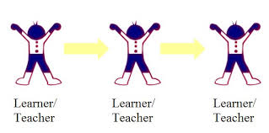
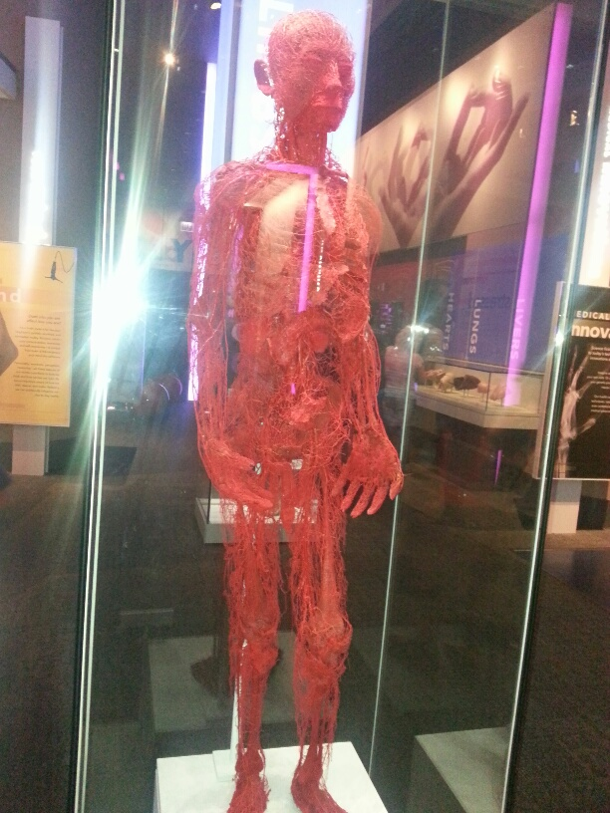
EVERYONE COUNTS
Place Your
Subtitle Here

