Slide 1
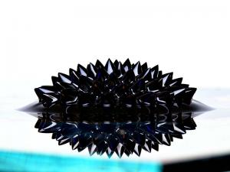
FERROFLUID
Place Your
Subtitle Here

Slide 2
ORIGIN & NATURE
1960 By NASA
Control liquid in space
Nano sized magnetic particles
Forms Spikes
Colloidal Suspension
5% magnetic, 85% carrier and 5% surfactant

Slide 3
USES
Mechanical Field: Machines
Removes Friction
Electronics:
Advanced Computer Disc
Blocks impurities
Biomedical Field: Eye Surgery
Aqueous Formulations

Slide 4
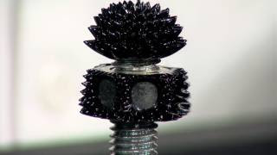
Transitional Page
PROPERTIES
Watch video!

